Slide 1
Today is the International Day of Prayer for the Persecuted Church
Organised in Ireland by

Slide 2
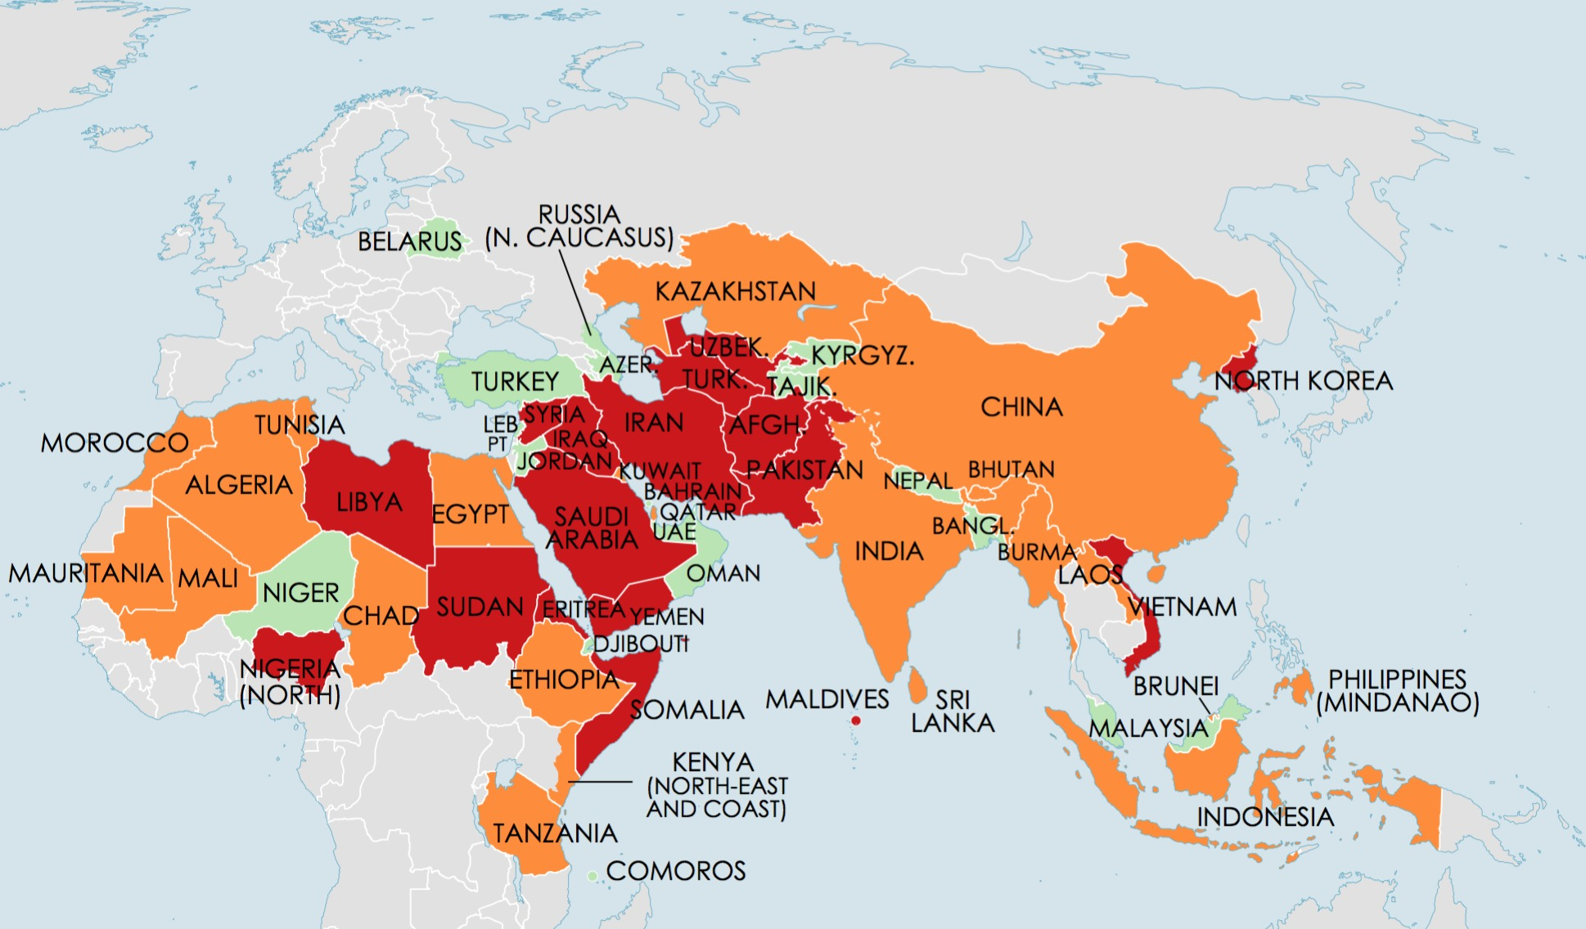
Christians face persecution in 60 countries
Red – Severe Orange – Significant Green – Limited

Slide 3
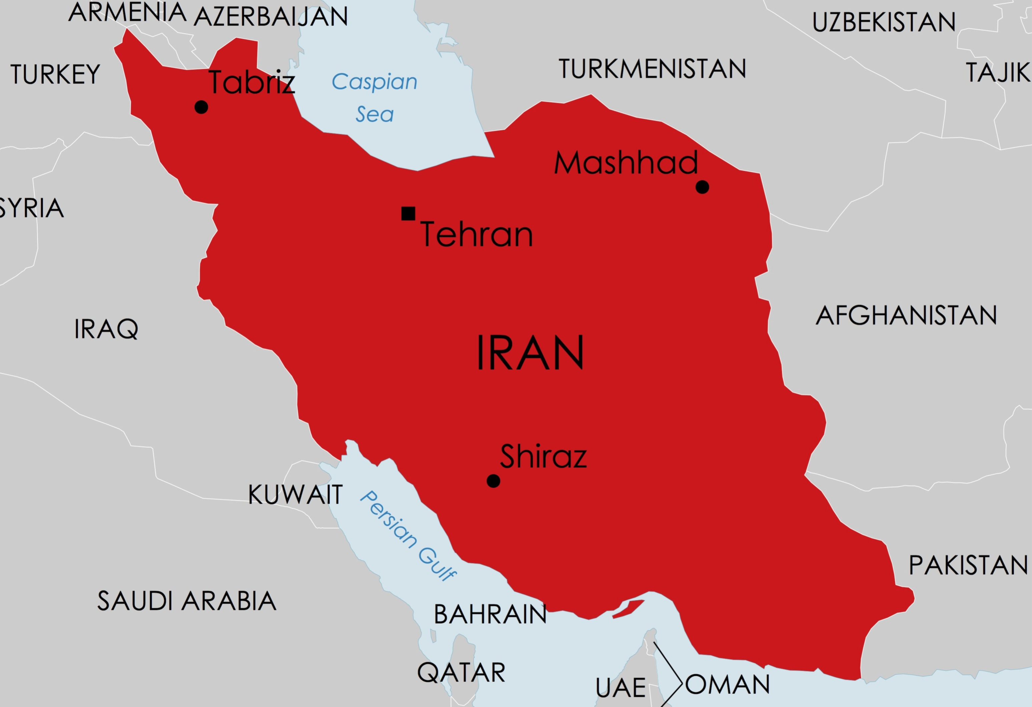

Slide 4
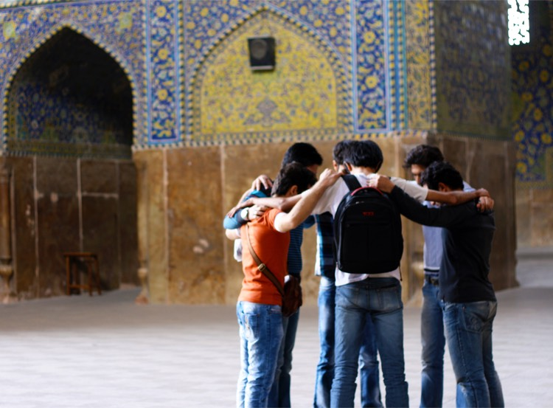
Today, we’re praying for the church in Iran which is growing but suffering severe persecution
On Easter Sunday 2016, 72 people (Christians and Muslims) were killed in a suicide attack targeting Christians in a park in Lahore

Slide 5
Almost 200 Christians have been arrested in the past year for meeting together or leading churches or distributing New Testaments

Slide 6
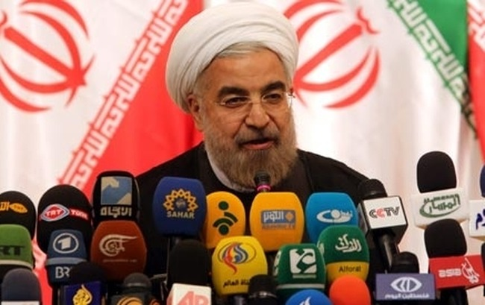
President Rouhani has promised improvements in human rights
but they have not occurred

Slide 7
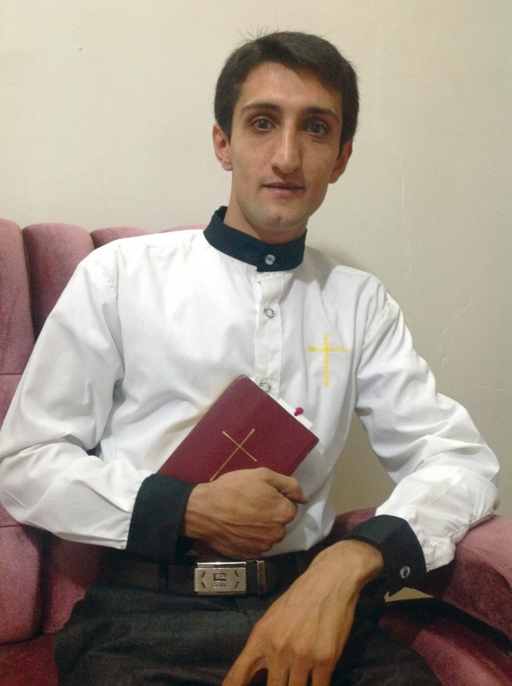
Ebrahim Firouzi has been in prison for 4 ½ years and has been ill-treated

Slide 8
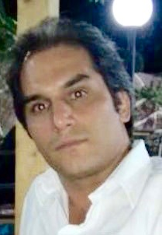
Hadi Askari has been in prison for over a year since security police arrested him at a picnic

Slide 9
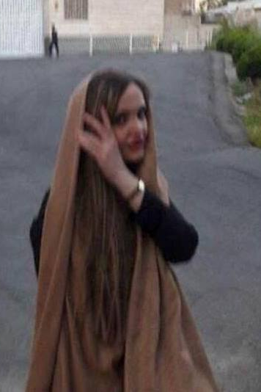
Maryam Zargaran was released from prison in August 2017 but is still under pressure from police

Slide 10
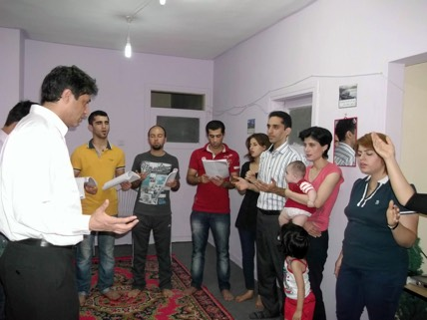
Iranian Christians gather
in secret house churches

Slide 11
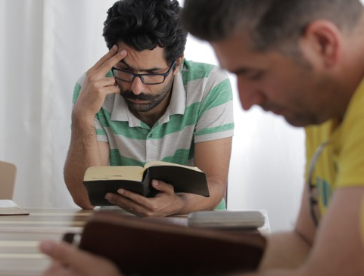
Leadership training is also done in secret

Slide 12
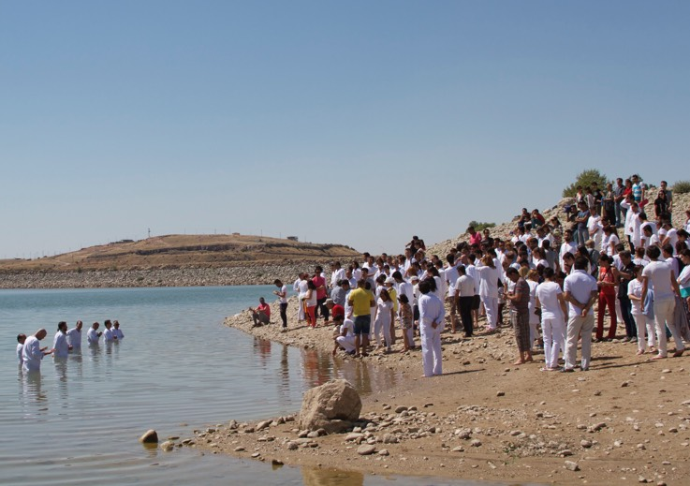
Baptisms are conducted under strict security
but are also occasions of great joy.

Slide 13
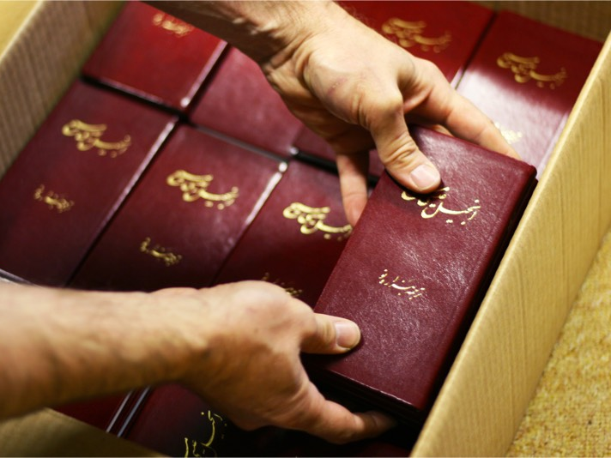
There is a huge hunger among Iranians
to read the New Testament
(despite a government ban)

Slide 14
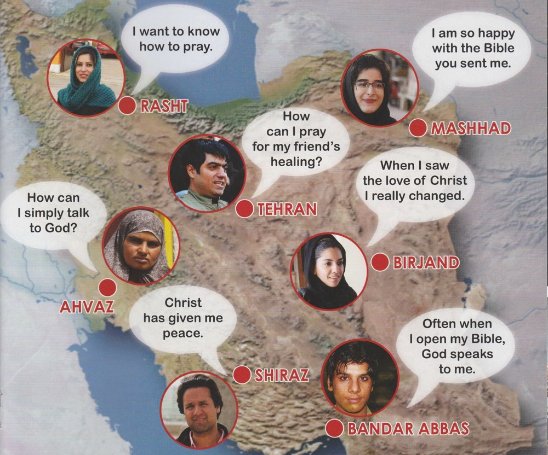
People all over Iran are viewing Christian satellite television and Christian internet sites

Slide 15
Iran will be featured
in the next Church in Chains magazine
(published in late November)
Subscribe to our weekly news updates at www.churchinchains.ie

