Slide 1
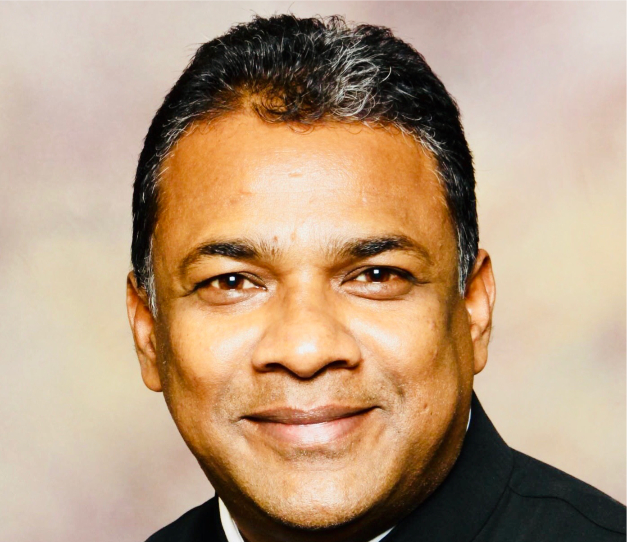
CHURCH IN CHAINS CONFERENCE
Saturday 15 September 11am – 4pm
Shibu Thomas
“Persecution of Christians
in India”
Clayton Hotel Liffey Valley
ALL WELCOME – ADMISSION FREE
Info: www.churchinchains.ie

