Slide 1

Today is IDOP –
The International Day of Prayer
for the Persecuted Church
Organised in Ireland by
Organised in Ireland by

Slide 2
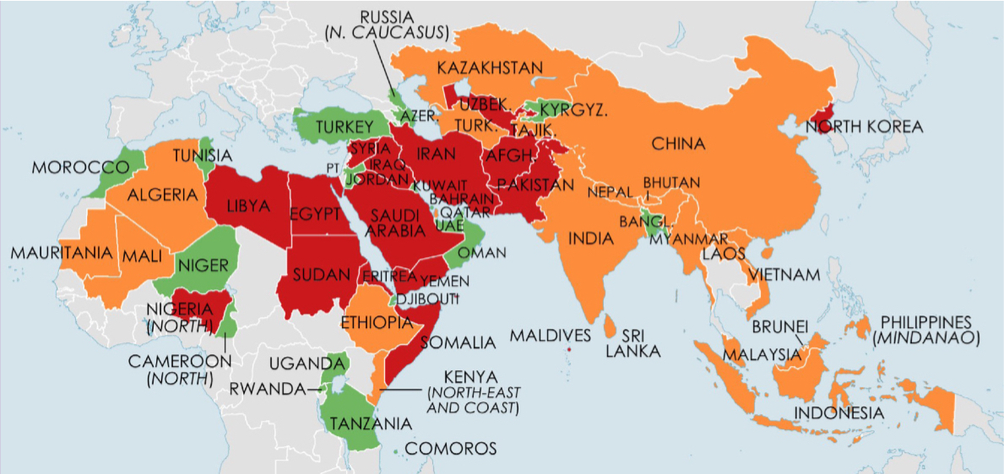
Christians face persecution in 60 countries
Red – Severe Orange – Significant Green – Limited

Slide 3
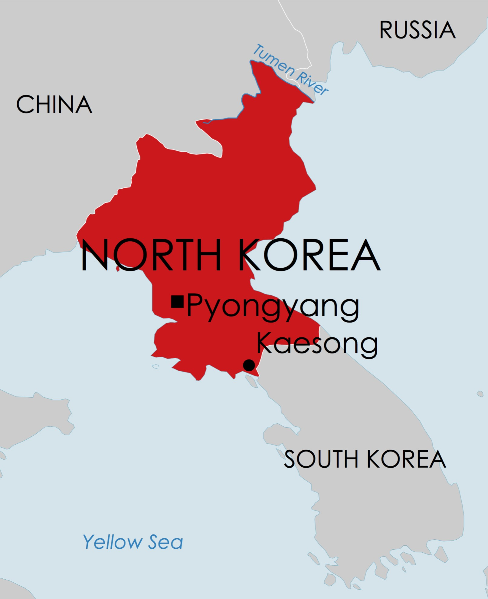

Slide 4
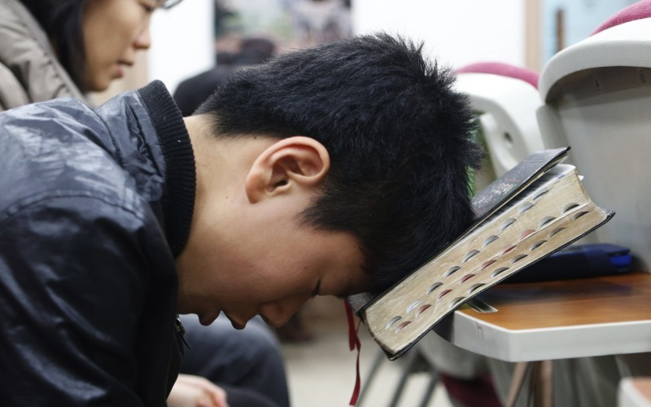
North Korea is the hardest place
in the world to live as a Christian

Slide 5
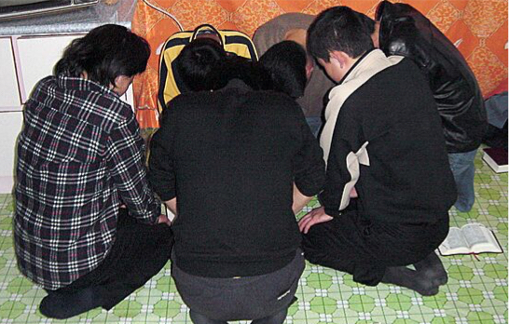
We pray for Christians in North Korea who have to keep their faith secret

Slide 6
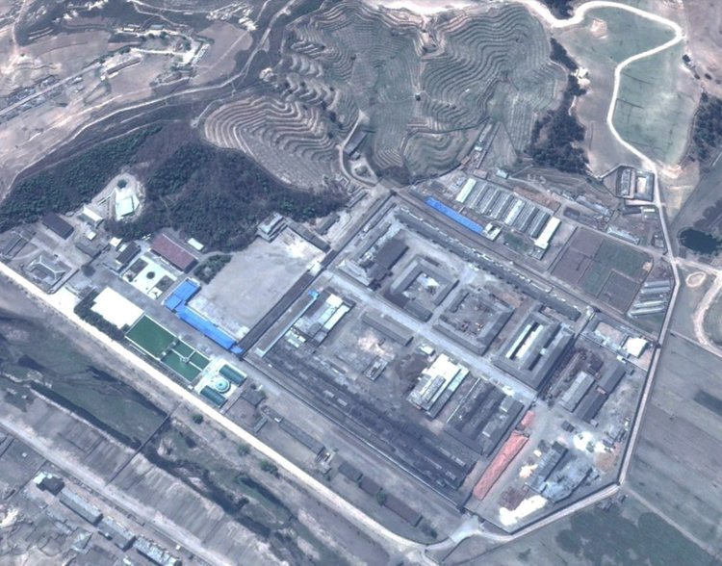
We pray for the thousands of Christians imprisoned in labour camps
throughout North Korea

Slide 7
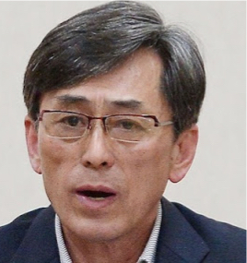
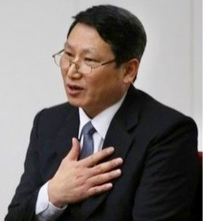
We pray for South Korean pastors
Kim Kuk-gi (left) and Kim Jong Uk (right) both serving life sentences
in North Korean labour camps

Slide 8
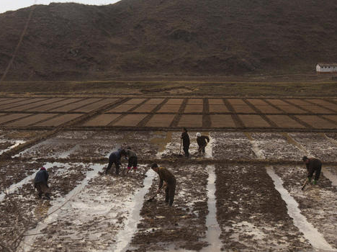
We pray for the people of North Korea, many of whom live in extreme poverty
and at risk of starvation

Slide 9
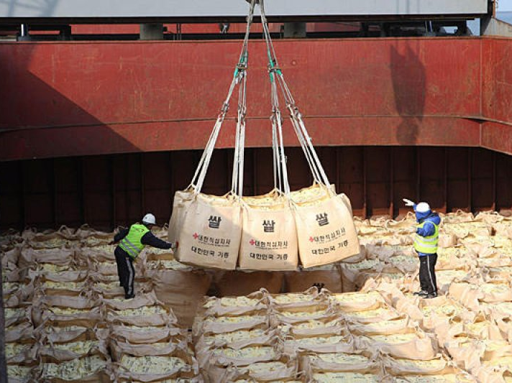
We pray for Christians and organisations providing much needed aid
for North Korean people

Slide 10
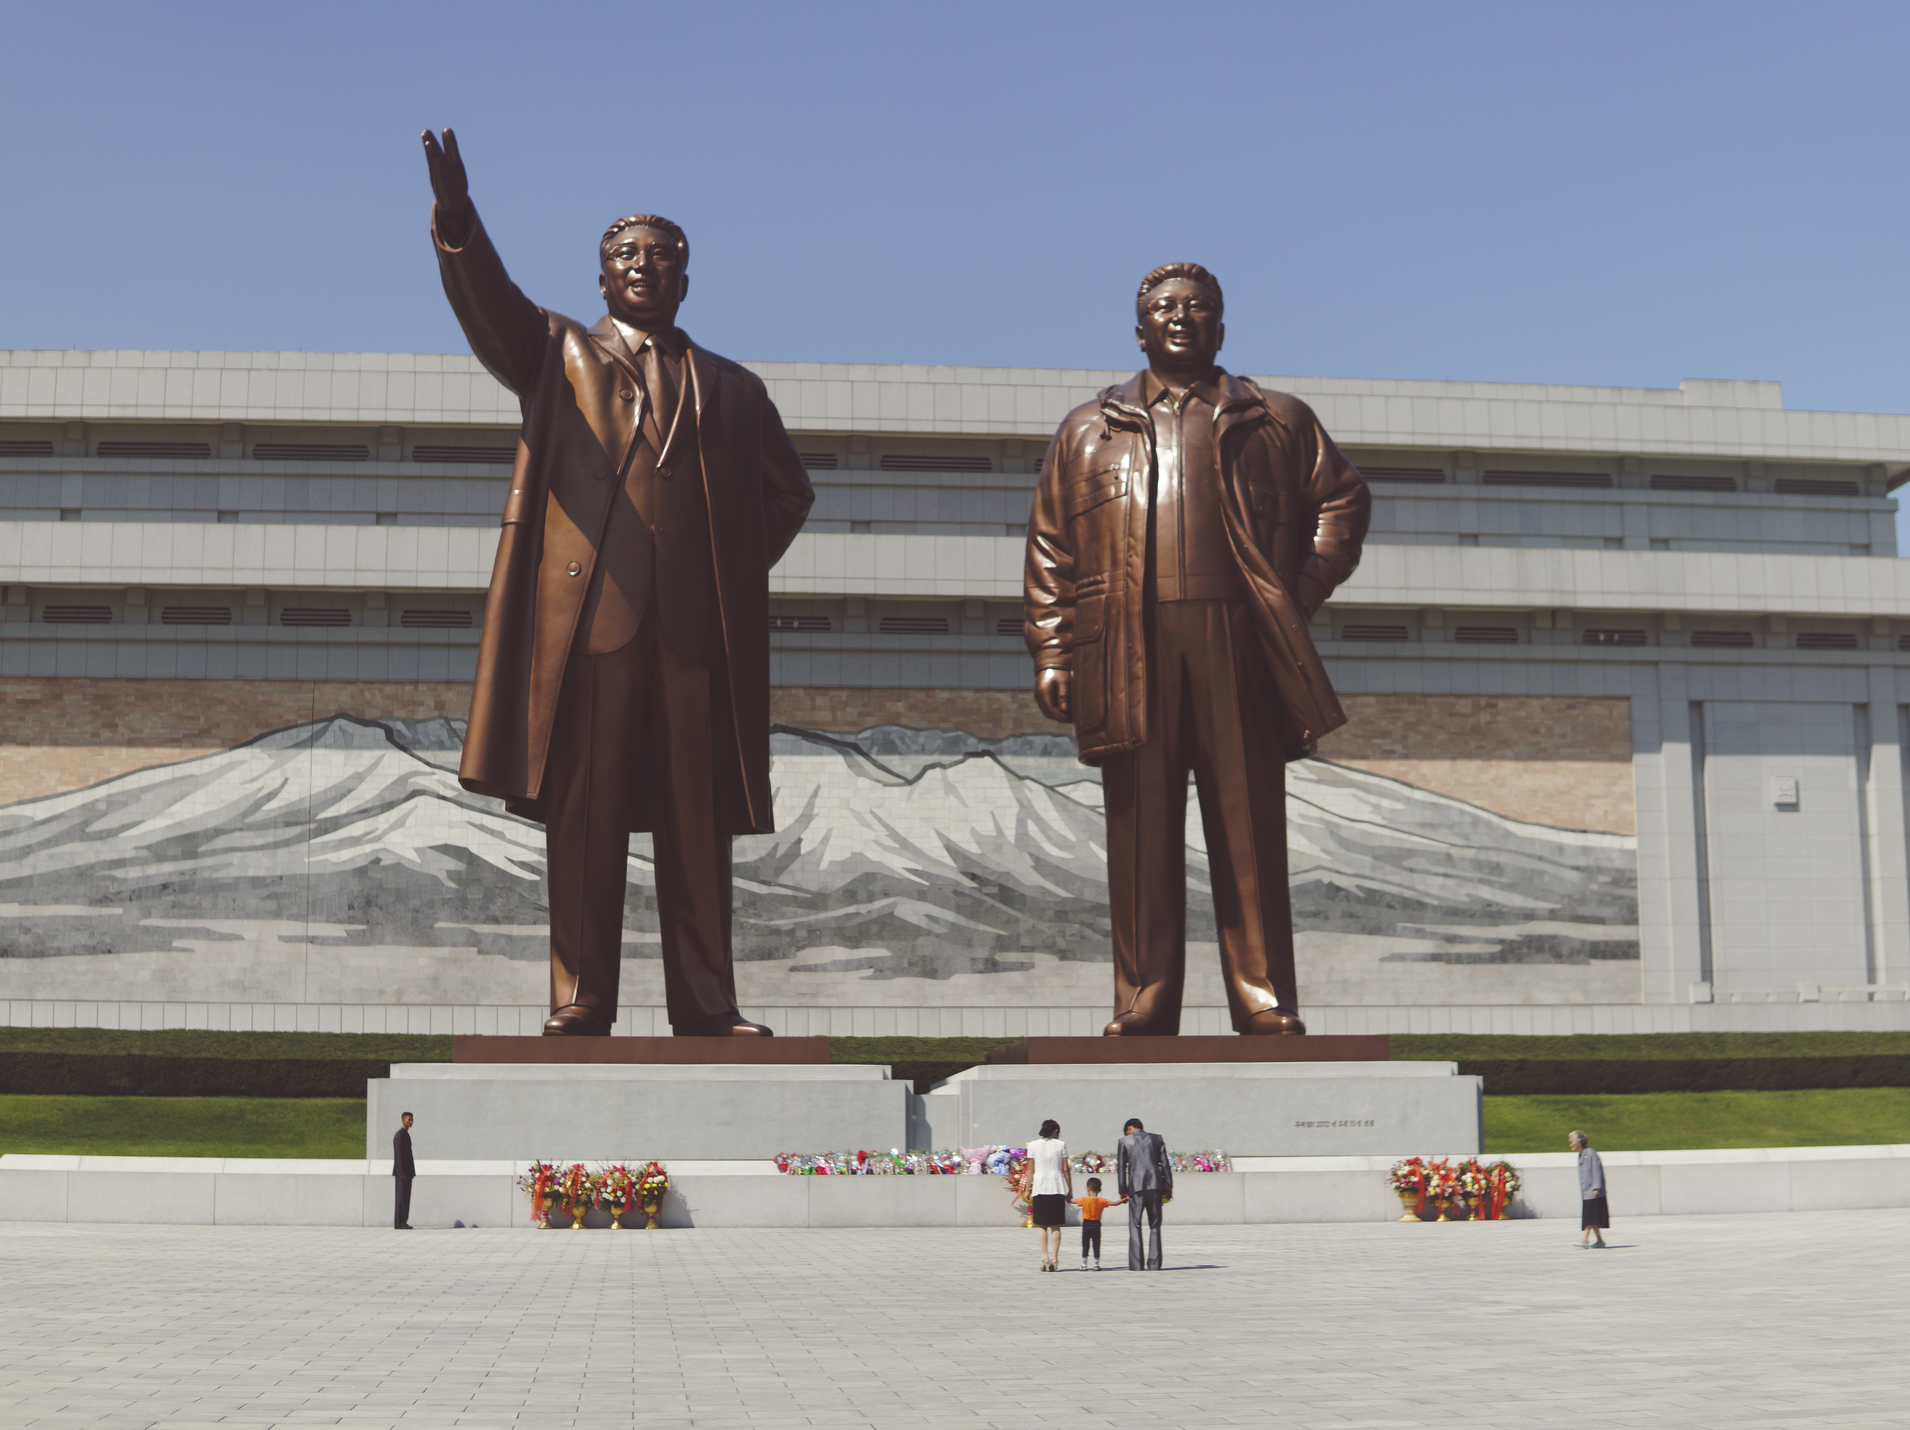
People bow before statues of previous leaders,
who are revered like gods.

Slide 11
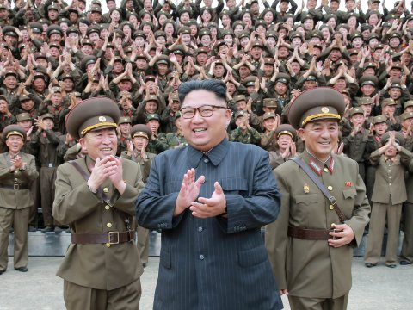
We pray for Kim Jong-un,
the supreme leader of North Korea.

Slide 12

North Korea will be featured
in the next Church in Chains magazine
(published later in November)
Order your copy or subscribe to
our weekly news updates at
www.churchinchains.ie

