Slide 1
IDOP
Today is the International Day of Prayer for the Persecuted Church
Organised in Ireland by

Slide 2
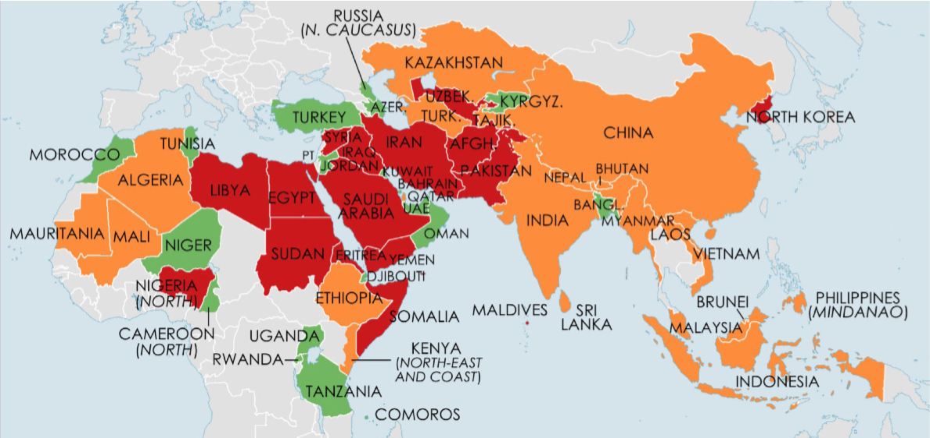
Christians face persecution in 60 countries
Red – Severe Orange – Significant Green – Limited

Slide 3
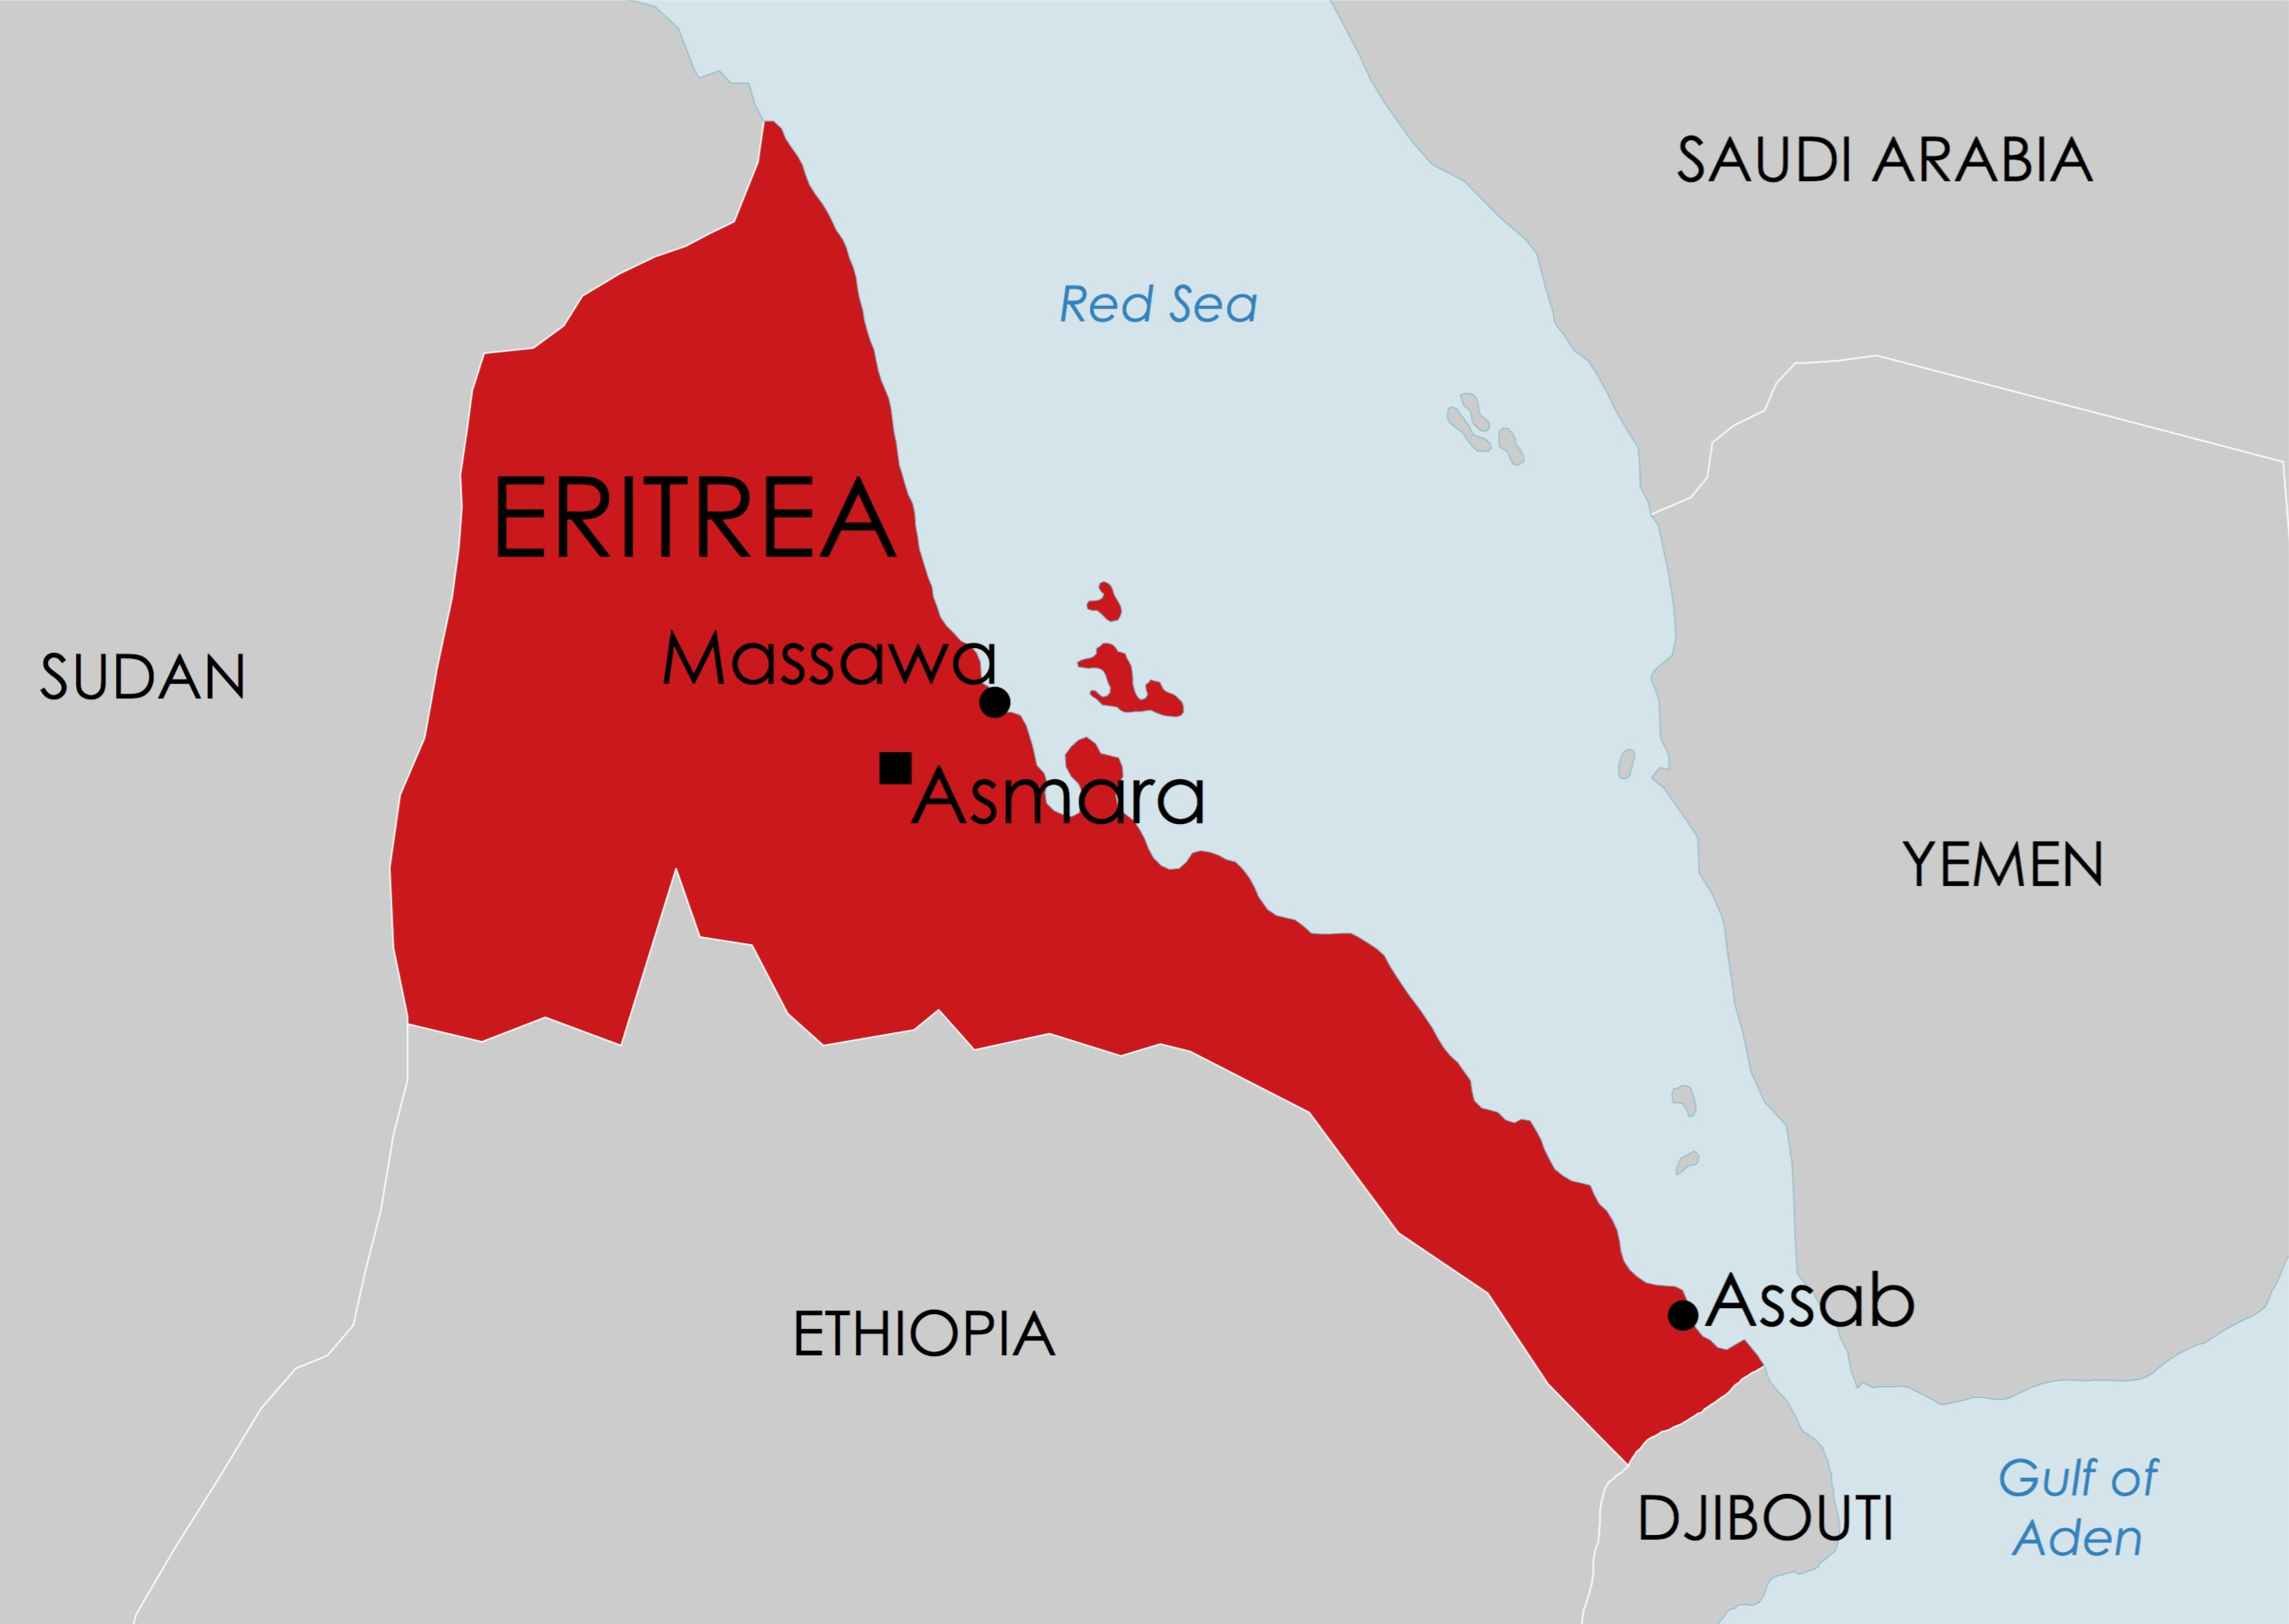
SUDAN
ETHIOPIA
Our focus today is on Eritrea in northeast Africa

Slide 4
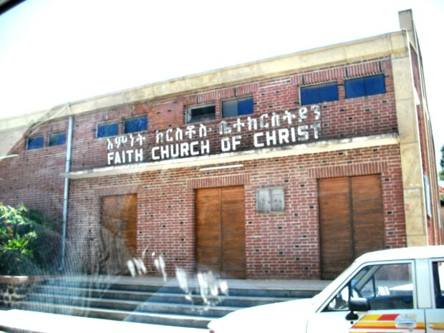
The Eritrean government harshly represses Christians

Slide 5
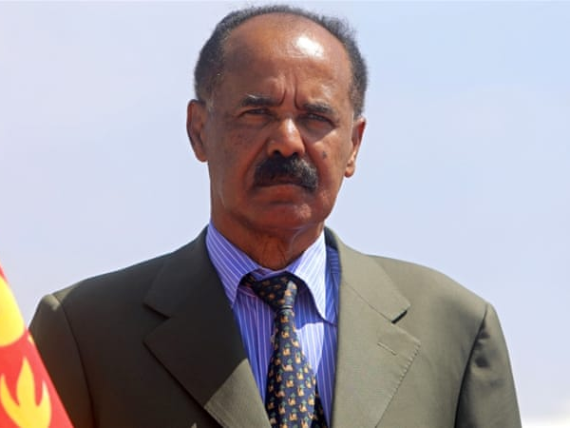
Pray that President Afewerki’s government
would change its ways

Slide 6
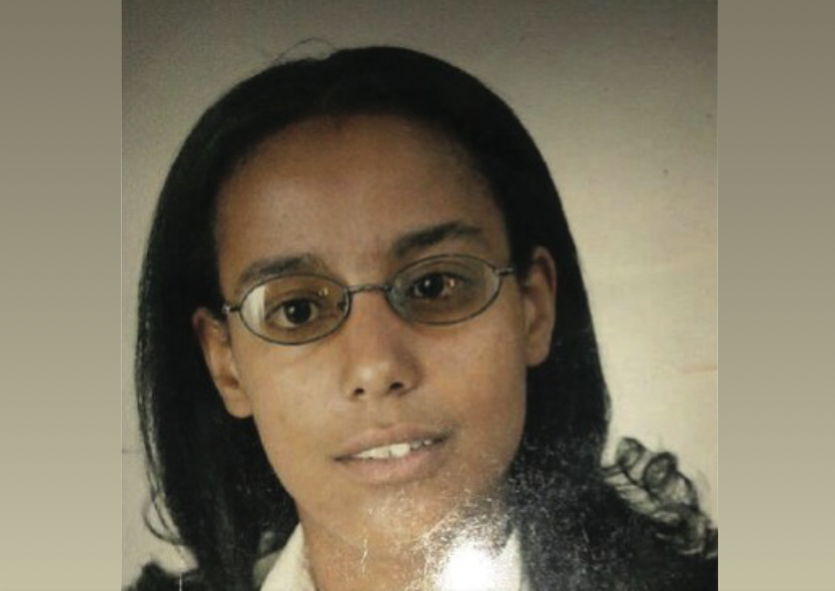
Twen Theodros has been imprisoned since 2005

Slide 7
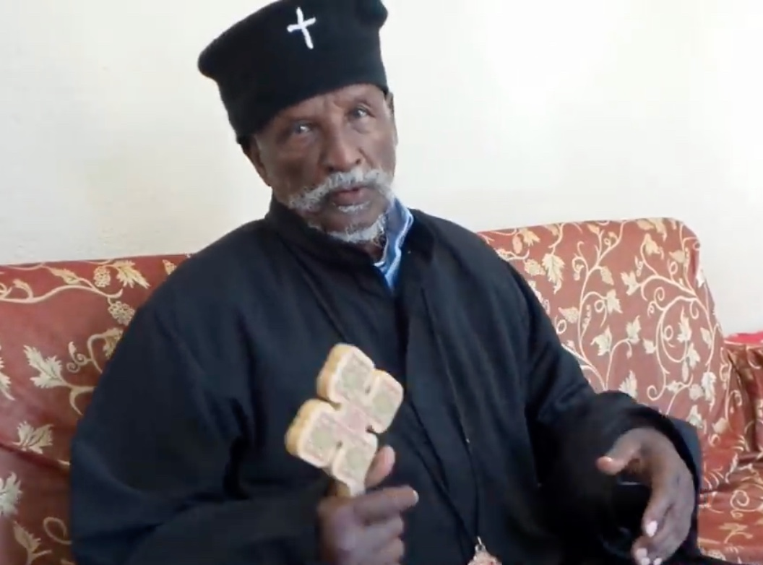
Patriarch Antonios – under house arrest since 2006

Slide 8
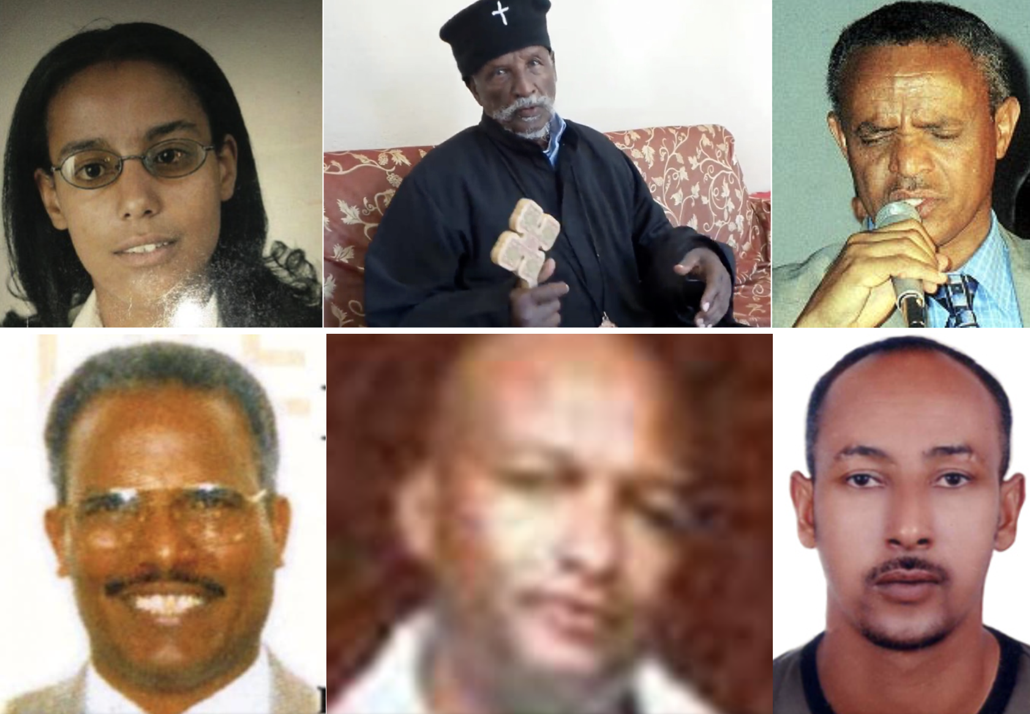
Pray for courage, strength and hope
for every Christian prisoner

Slide 9
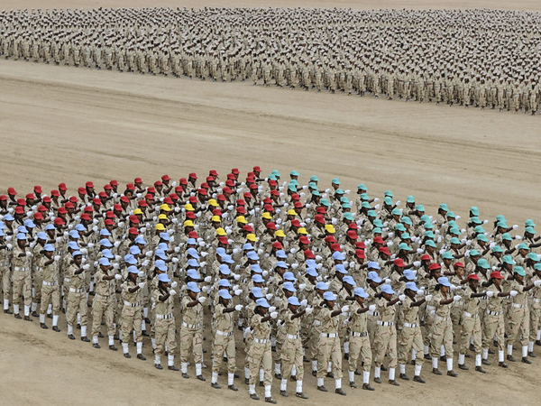
Military service is mandatory and open-ended

Slide 10
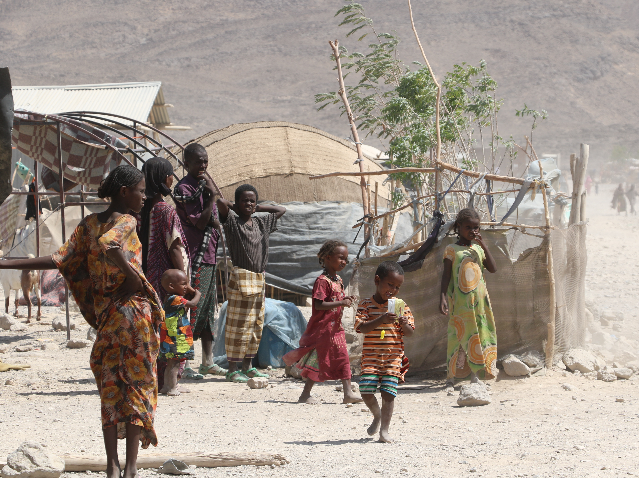
Many Eritreans have fled and become refugees

Slide 11
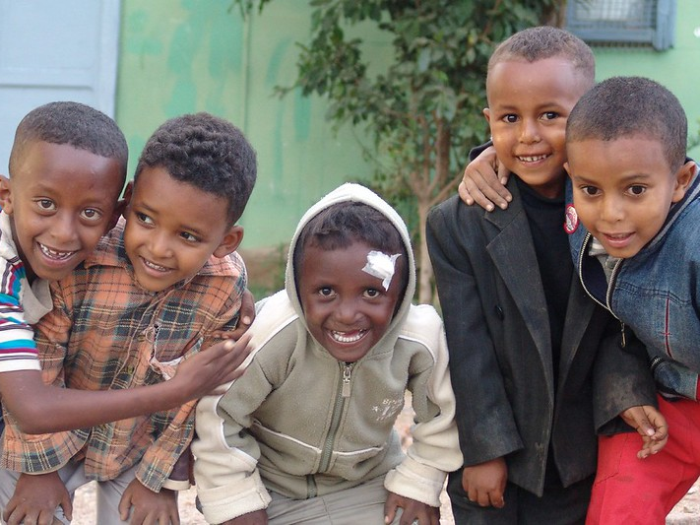
Pray that God would heal the nation

Slide 12
Eritrea will be featured
in the next Church in Chains magazine
(published later in November)
Order your copy or subscribe to
our weekly news updates at www.churchinchains.ie

