Slide 1
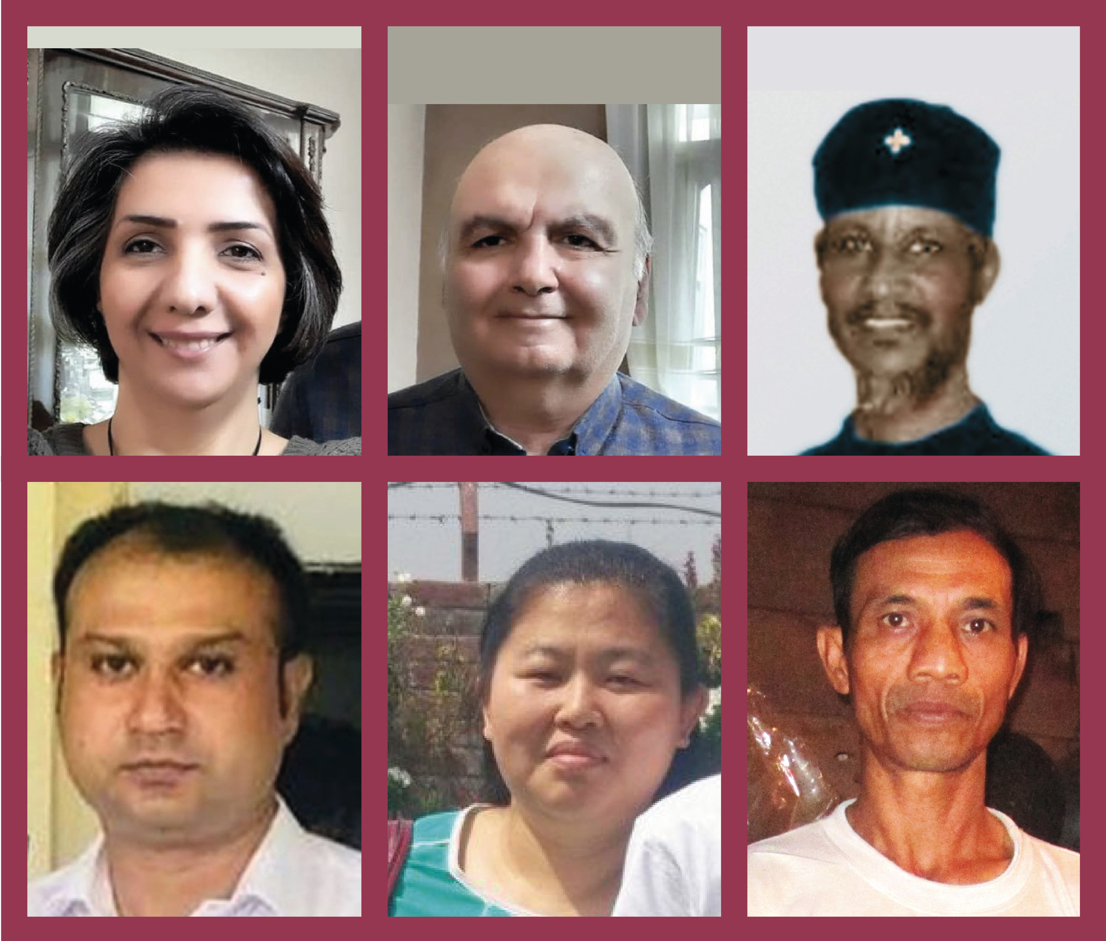
2023 Lent Prayer Project

Slide 2
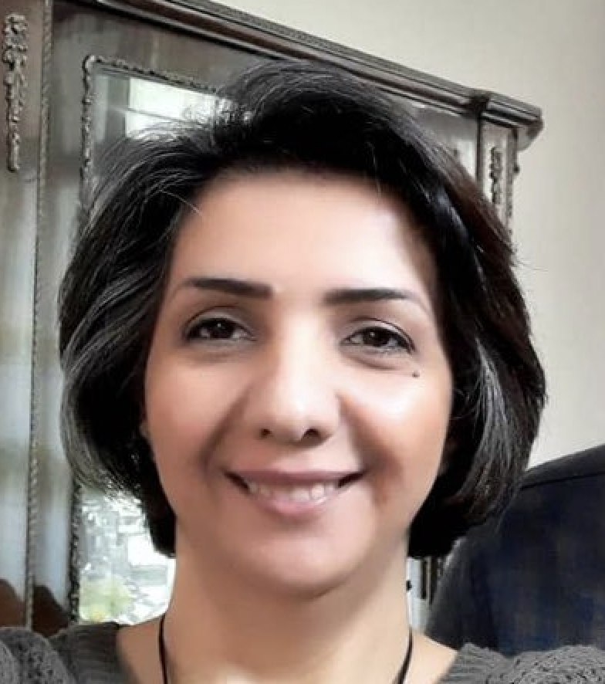
Week 1 – Lent Prayer Project
Sara Ahmadi
Iran
8-year prison sentence

Slide 3
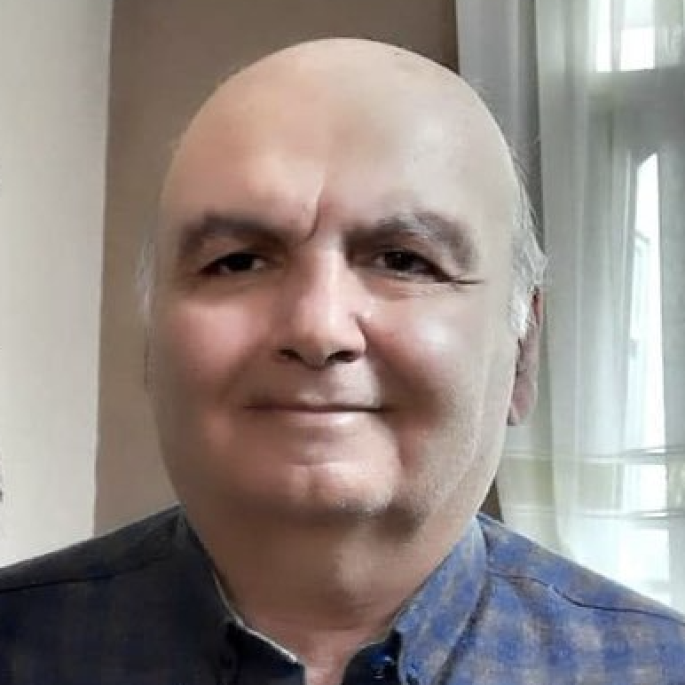
Week 2 – Lent Prayer Project
Homayoun Zhaveh
Iran
2-year prison sentence

Slide 4
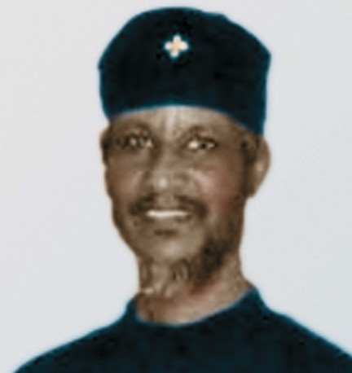
Week 3 – Lent Prayer Project
Gebremedhin Gebregiorsis
Eritrea
In prison
for past 18 years

Slide 5
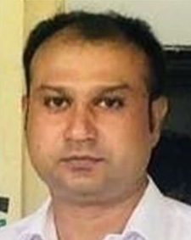
Week 4 – Lent Prayer Project
Asif Pervaiz
Pakistan
In prison for 9 ½ years
on false charges

Slide 6
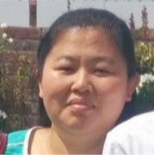
Week 5 – Lent Prayer Project
Hao Zhiwei
China
8 year
prison sentence

Slide 7
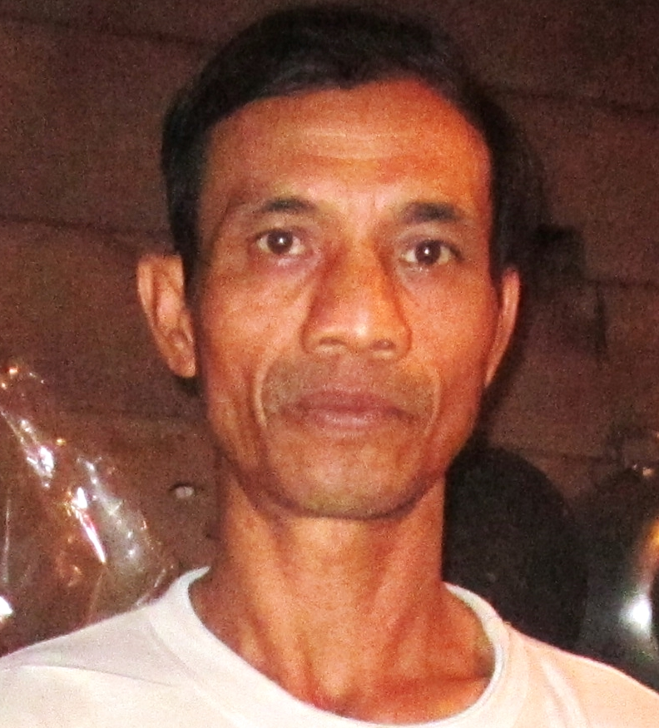
Week 6 – Lent Prayer Project
Y Pum Bya
Vietnam
14 year
prison sentence

