Slide 1
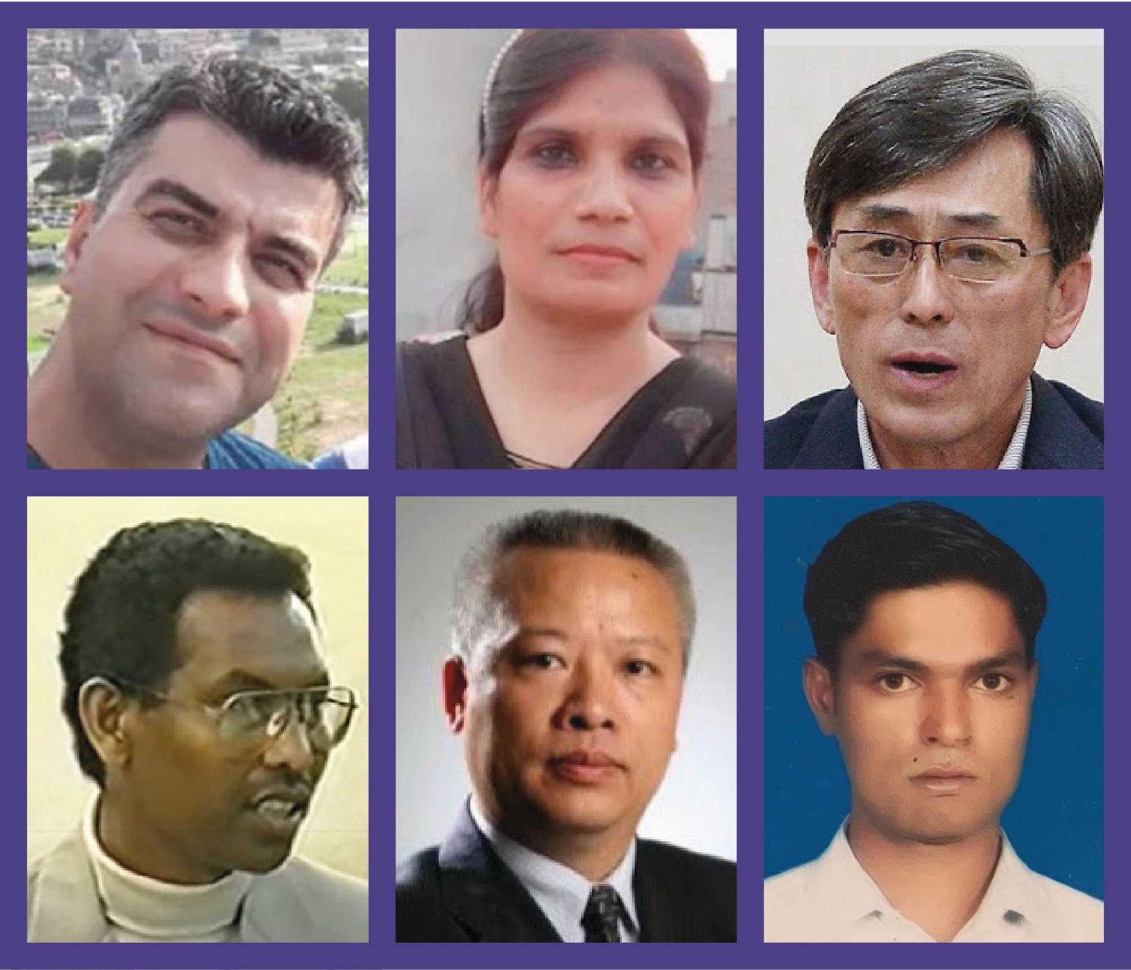
2024 Lent Prayer Project

Slide 2
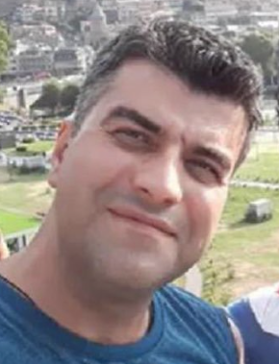
Week 1 – Lent Prayer Project
Mehdi Akbari
Iran
10-year prison sentence

Slide 3
Week 2 – Lent Prayer Project
Shagufta Kiran
Pakistan
Waiting for trial
for past 3 years

Slide 4
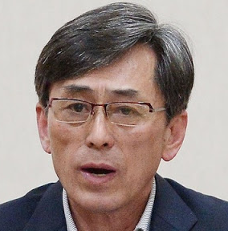
Week 3 – Lent Prayer Project
Kim Kuk-gi
North Korea
Serving life sentence
since 2014

Slide 5
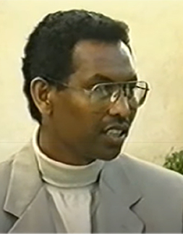
Week 4 – Lent Prayer Project
Futsum Gebrenegus
Eritrea
In prison
for past 20 years

Slide 6
Week 5 – Lent Prayer Project
Zhang Chunlei
China
Tried in 2022 - verdict and sentence not known

Slide 7
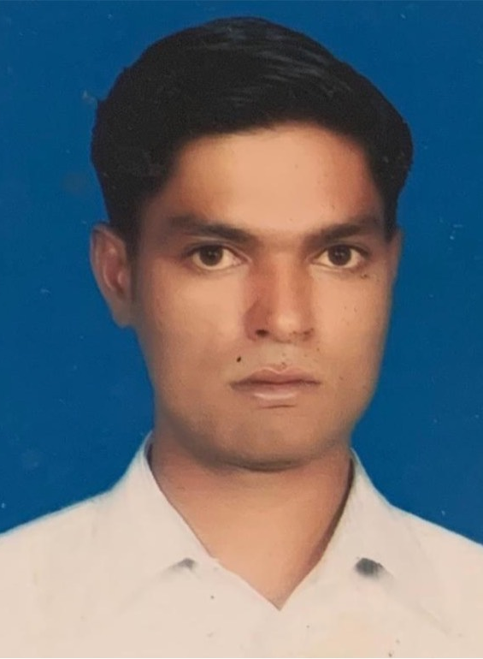
Week 6 – Lent Prayer Project
Ashfaq Masih
Pakistan
Sentenced to death
in 2022 – awaiting appeal

